Slide 1
UNIVERSAL IDENTITY NEXUS
by
Tushar Yadav [885174284]
submitted to
Prof. Kenneth Kung
CPSC 589 – Seminar APRIL 30, 2024

Slide 2

Universal Identity Nexus
A centralized, secure, and scalable system for managing and accessing personal information, ensuring efficiency, convenience and privacy

Slide 3

Introduction
The UIN system is a revolutionary approach to managing personal information securely and efficiently.
In today's digital age, the need for a centralized system for managing personal information has never been more critical.
The UIN system aims to address this need by providing a secure, scalable, and user-friendly platform for managing personal information.
Notes:
Increasing Volume of Personal Information: With the proliferation of digital services and online transactions, individuals are generating and sharing more personal information than ever before. This includes information such as contact details, financial data, and health records.
Complexity of Data Management: Managing personal information across multiple platforms and services can be complex and challenging. Individuals often have to update their information separately for each service, leading to inefficiencies and potential errors.
Growing Concerns about Privacy and Security: There is a growing awareness and concern about privacy and security issues related to personal information. High-profile data breaches and privacy scandals have highlighted the need for better data protection measures.
Regulatory Requirements: Governments around the world are introducing stricter regulations to protect personal data, such as the General Data Protection Regulation (GDPR) in Europe and the California Consumer Privacy Act (CCPA) in the United States. These regulations require organizations to implement robust data protection measures and provide individuals with more control over their personal information.
Need for Efficiency and Convenience: A centralized system for managing personal information can improve efficiency and convenience for both individuals and organizations. It can streamline data management processes, reduce duplication of efforts, and ensure that information is accurate and up to date.

Slide 4

Problem Statement
Current systems for managing personal information are fragmented, inefficient, and lack adequate security measures.
Individuals often must update their information separately across multiple platforms and services, leading to duplication of efforts and potential errors.
Existing solutions for managing personal information, such as government databases and private sector systems, are often siloed and lack interoperability.
Privacy and security concerns related to personal information are growing, with data breaches and privacy scandals making headlines regularly.
There is a need for a more centralized and secure system for managing personal information that addresses these challenges effectively.

Slide 5

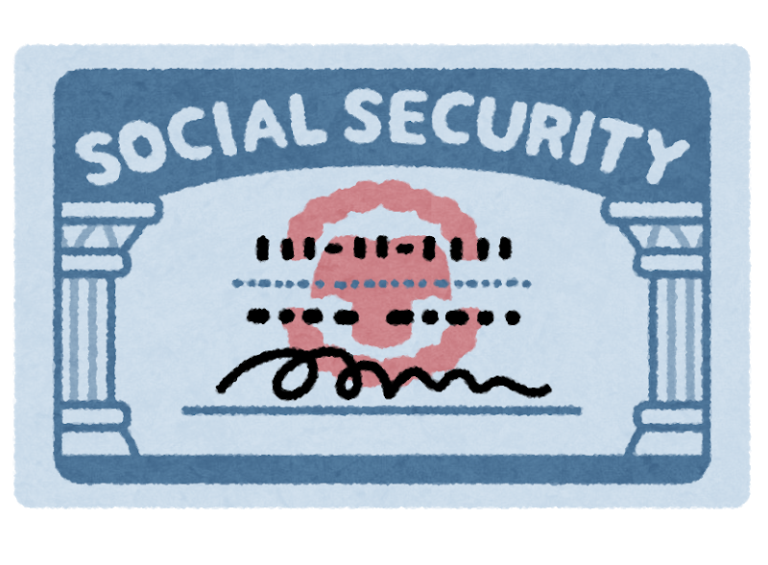

Existing Solutions and Drawbacks
Existing Systems Include…
National Identification Systems: Many countries have national identification systems that centrally store personal information such as name, address, and identification numbers. Examples include the Aadhaar system in India and the Social Security system in the United States.
Health Information Exchanges (HIEs): HIEs are centralized systems that allow healthcare providers to share and access patient health information electronically. Examples include the Health Information Exchange for New York State (SHIN-NY) and the Nationwide Health Information Network (NwHIN) in the United States.

Slide 6
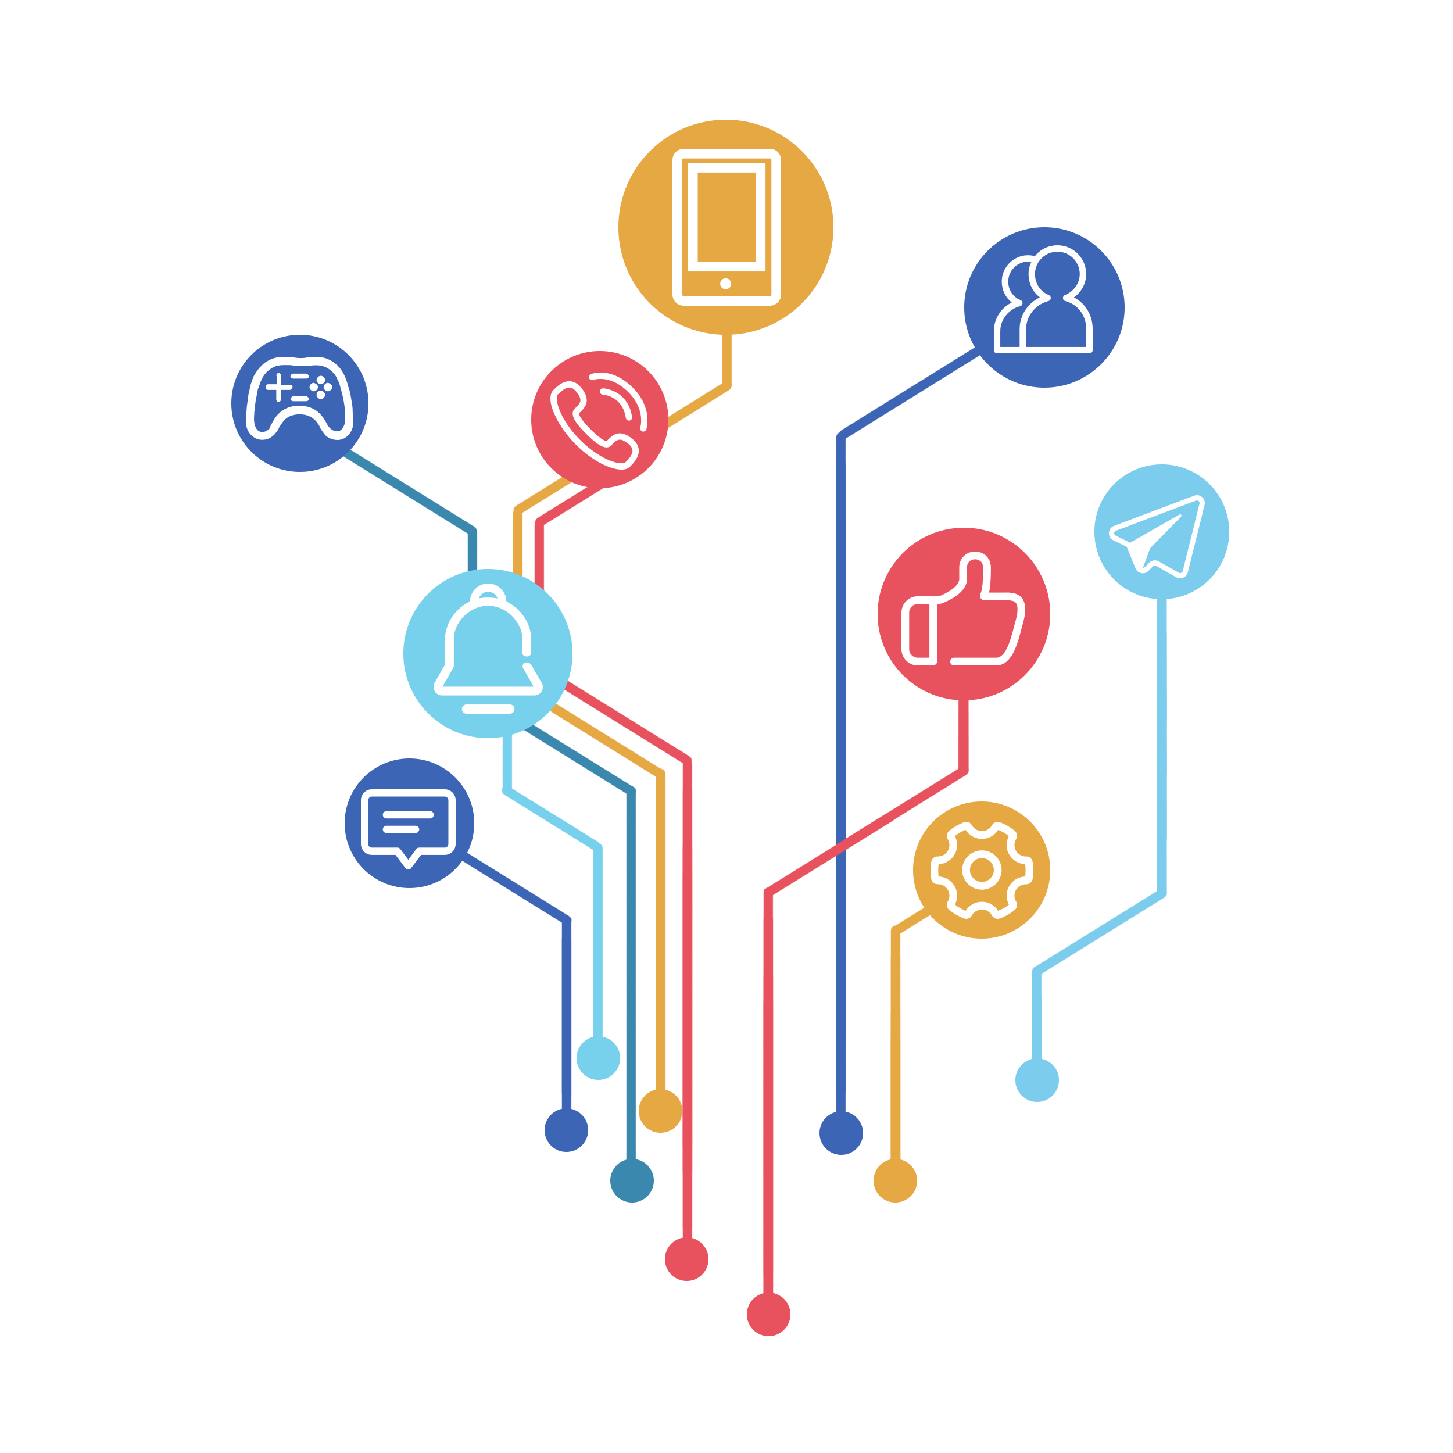
Existing Solutions and Drawbacks
Existing Systems Include…
Financial Information Systems: Financial institutions often use centralized systems to manage customer information, including account details, transaction history, and credit scores. Examples include banking systems and credit reporting agencies.
Corporate Customer Relationship Management (CRM) Systems: Many companies use centralized CRM systems to manage customer information and interactions. These systems store data such as customer contact details, purchase history, and preferences.

Slide 7

DrawbackS
FRAGMENTATIONS
Lack of Interoperability
Security Vulnerability
Privacy Concerns
Inefficiency
Lack of Control
Regulatory Compliance

Slide 8
Proposed System
The Universal Identity Nexus (UIN) system is a centralized, secure, and scalable solution for managing personal information. It aims to address the challenges of existing systems by providing unified platform for storing and sharing personal information
Key Features -------- >
Centralized storage: Central database system ensuring consistency and accessibility.
Secure Access: Robust security measures including encryption, access control, 2-step authentication to protect personal information.
Interoperability: Allowing seamless integration and data exchange.
User- Friendly: The system provides a user-friendly interface for individuals to manage their information easily and efficiently
& Greater Control over personal information.

Slide 9

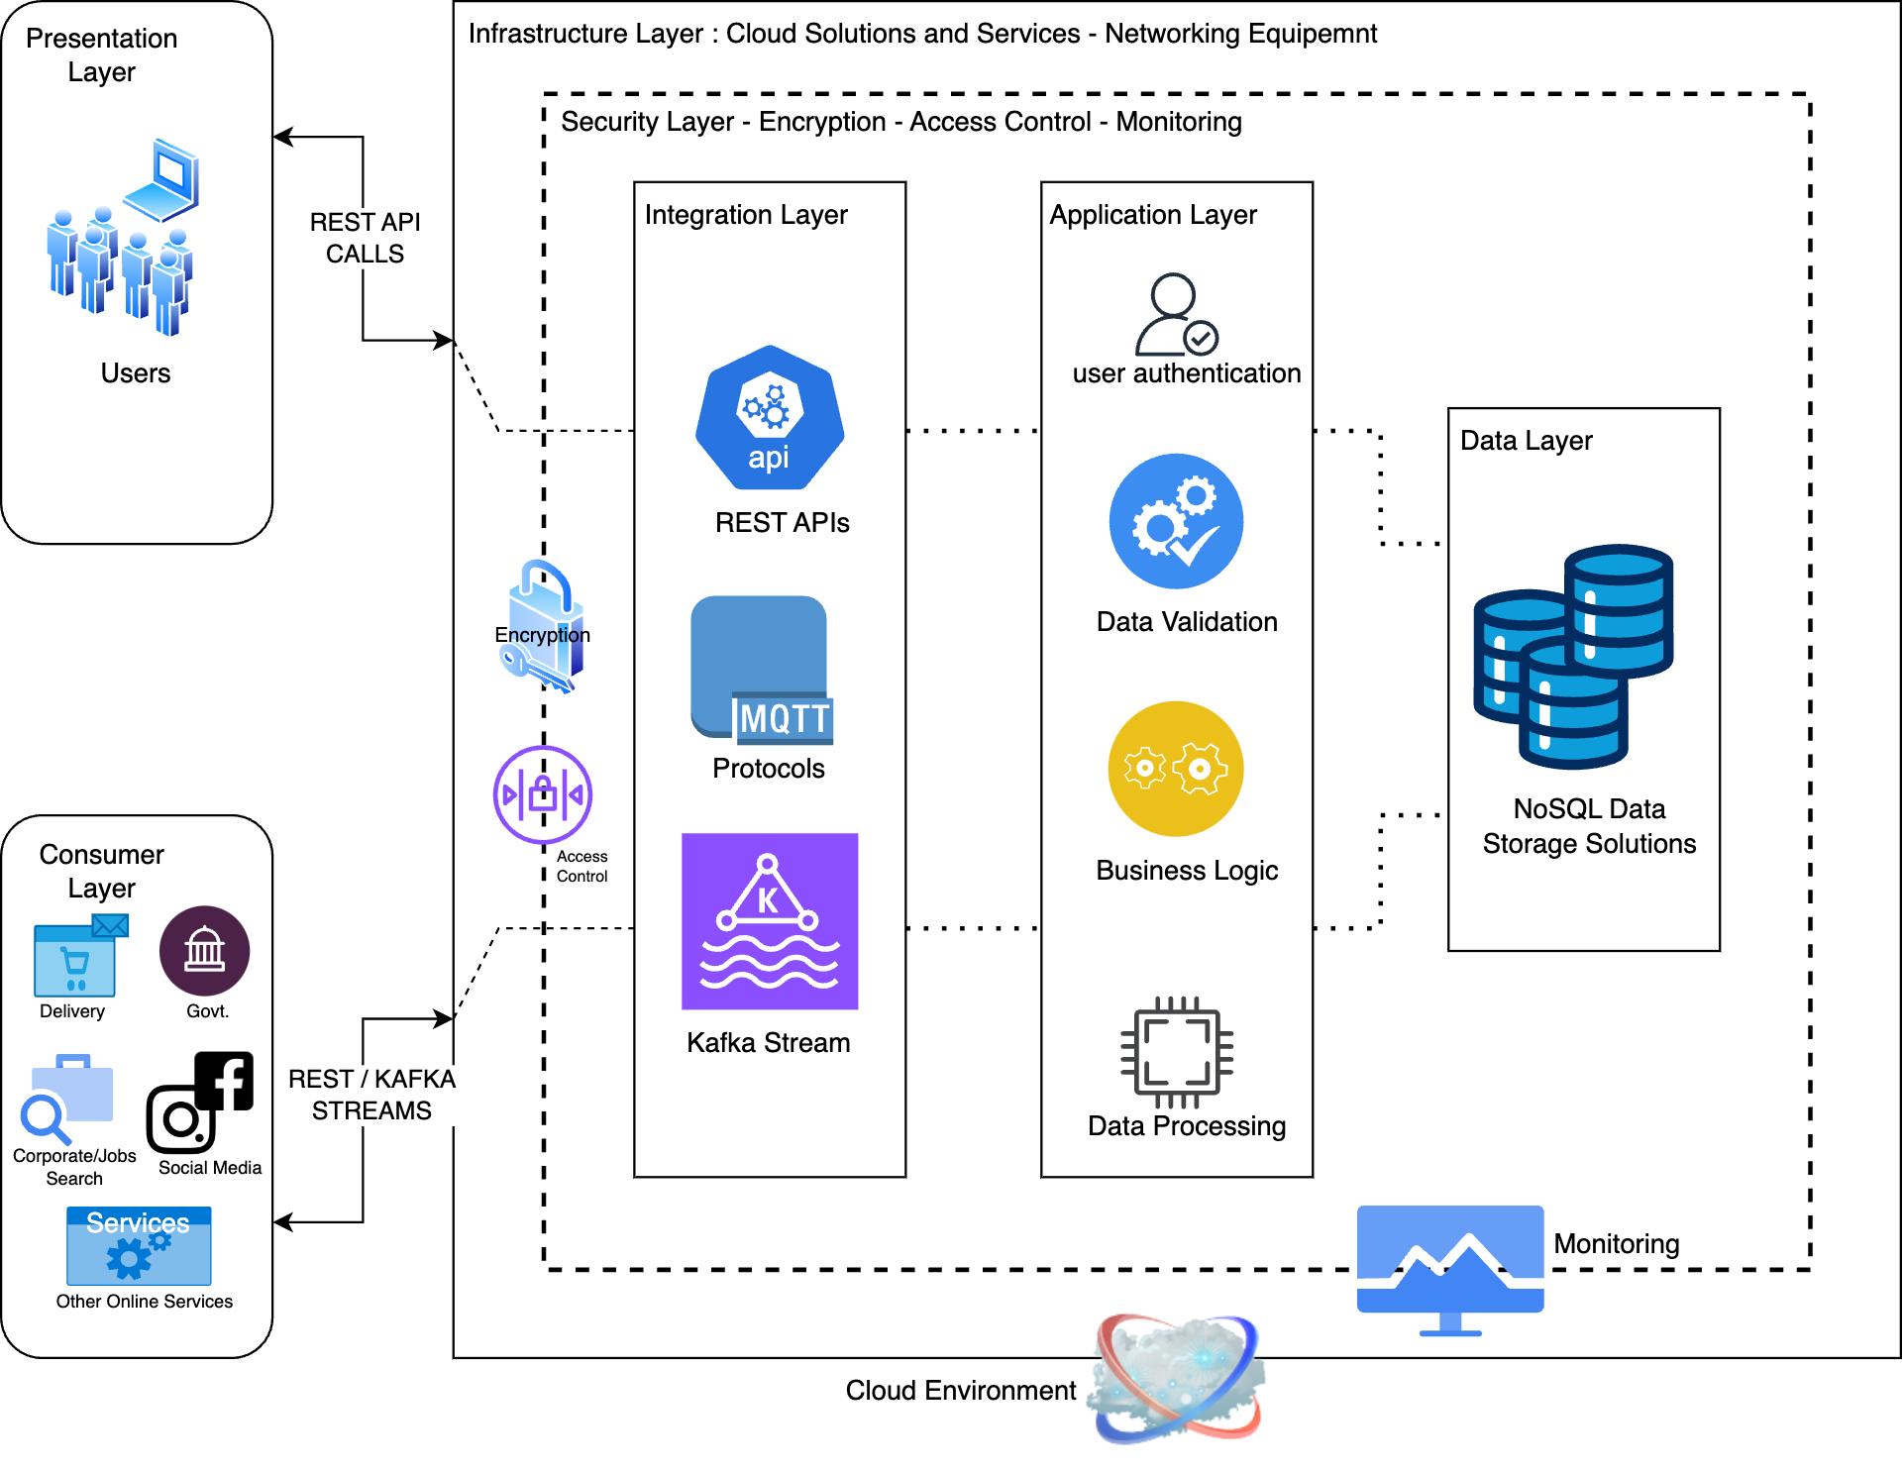
A r c H I t e c t u r e
DESIGN

Slide 10


Components
Presentation Layer: Represented by web and mobile interfaces for user interaction.
Application Layer: Represented by modules for user authentication, data validation, and API handling.
Data Layer: Represented by a centralized database with encryption and access control.
Integration Layer: Represented by APIs and protocols for external system integration.
Security Layer: Represented by encryption, access control, and monitoring components.
Infrastructure Layer: Represented by servers, networking equipment, and hardware
Client Layer: Represent clients like shopping apps, social media platforms, or other sites that will be using your system for users' information

Slide 11












HOW will THIS WORK (user side)…
Step
Location and Addresses
Location & Addresses
Contact No.
i
Contact No.
i
Email IDs
i
Usernames & Passwords
Email IDs
Usernames & Passwords

Slide 12




HOW will THIS WORK…
Step
Location and Addresses
Contact No.
i
Virtual Card
i
Email IDs
i
00-002-####
UIN Number
Usernames & Passwords

Slide 13





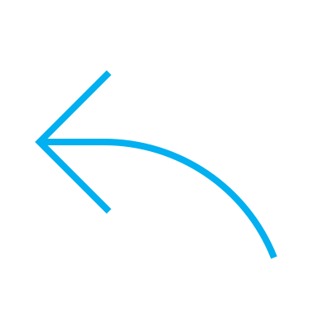
HOW will THIS WORK…
Step
i
i
i
QR CODE
i
i
NFC | Wallet
Multiple Profiles
Work
Personal 1
Personal 2
Job Search
Education
Gaming
00-002-####
UIN Number

Slide 14






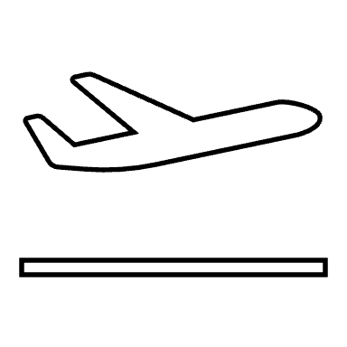
HOW will THIS WORK (Clients Side)…
Step
i
i
Websites:-
Shopping
Job Boards
Social Media
Services
Web Applications
Web Portals
Competitive Sites
Gambling Sites
Office Buildings
Hotels
Police Stations
Hospitals
Shops
Public Transports
Stadiums / Arena
QR CODE
i
NFC | Wallet
00-002-####
UIN Number

Slide 15







HOW will THIS WORK (Clients Side)…
i
Step
Online
In-Person
Add line 1
i
Add line 2
i
i
Contact No.:
You walk into a store/airport/Stadium
Either open the UIN App on your mobile device or the UIN Web App
For hand-held scanners, you show your Profile’s QR Code
For Standard NFC Pads, you can either enter your UIN ID manually or use your virtual card and add tap and share using NFC
or
UIN ID:
submit
00-002-####
Upon clicking submit user should receive approval
request on their registered devices or emails
Email - OTP or Link Verification
i
Mobile - OTP or Push Notification

Slide 16
Features to the user
The Universal Identity Nexus (UIN) system offers a range of features that empower users to control and manage their personal information:
Access Logs: Users can track and view logs of when and by whom their information is accessed, providing transparency and accountability.
Data Analytics: Users can opt-in to data analytics features to derive insights from their information, such as health trends or location-based services.
Service Blocking: Users have the option to block services from accessing their data, giving them control over their privacy.
Access Time Intervals: Users can set time intervals during which a particular service can access their data, providing additional control over data sharing.
Consent Management: Users can manage their consent settings, including revoking consent for data sharing with third-party services.
Data Portability: Users can easily export their personal information in a standardized format, enabling data portability and interoperability.

Slide 17
SECURITY
The Universal Identity Nexus (UIN) system prioritizes security to protect personal information from unauthorized access and data breaches.
Key security features of the UIN system include:
Encryption: All personal information is encrypted to protect it from unauthorized access.
Two-Factor Authentication (2FA): Two-factor authentication is used to add an extra layer of security by requiring users to provide two forms of verification before accessing their accounts.
Monitoring: The system includes monitoring tools to detect and respond to security threats in real-time.
Auditing: Regular audits are conducted to ensure compliance with security policies and regulations.
Data Request Approvals: Requests for personal information are subject to approval, and users are notified via push notifications or email OTPs for verification.
The UIN system also complies with relevant data protection regulations, such as GDPR and CCPA, to ensure the privacy and security of personal information.

Slide 18
Future Scope
The Universal Identity Nexus (UIN) system is designed to be scalable and adaptable to future needs and technologies.
Future enhancements and developments for the UIN system may include:
Decentralization: Explore the possibility of decentralizing the UIN system to provide users with more control over their personal information. For example, implementing Zero Knowledge Proof (ZKP) protocols could enhance privacy by allowing users to prove the authenticity of their information without disclosing the actual information itself.
Enhanced Security Features: Continuously improve security measures to protect personal information from evolving threats. For example, implementing multi-factor authentication (MFA) could add an extra layer of security by requiring users to provide two or more verification factors.
Advanced Data Analytics: Implement advanced data analytics capabilities to derive valuable insights from user information while ensuring privacy and security. For example, implementing differential privacy techniques could allow for the analysis of aggregated data without exposing individual user information.
Cross-Border Data Sharing: Explore possibilities for secure cross-border data sharing while ensuring compliance with relevant regulations. For example, implementing secure data exchange protocols could enable encrypted data transfer between different jurisdictions.
Improved User Experience: Continuously enhance the user experience to make managing personal information more intuitive and user-friendly. For example, implementing a user-friendly dashboard could provide users with a centralized view of their personal information and settings.

Slide 19

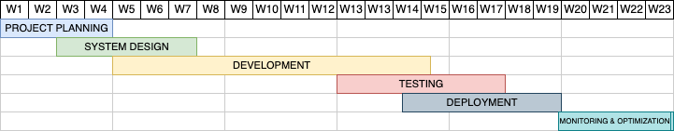
TIMELINE
Milestone #1
BACKNED SYSTEM,
WEB APPLICATION,
AUTHENTICATION AND VALIDATION PROCESS
Milestone #2
Mobile Applications IOS & Android.
Rotating QR Codes.
Adding generation of virtual card that can be added to Apple or Samsung Wallets.

Slide 20
Related Research & References
S. Friebe, I. Sobik and M. Zitterbart, "DecentID: Decentralized and Privacy-Preserving Identity Storage System Using Smart Contracts," 2018 17th IEEE International Conference On Trust, Security And Privacy In Computing And Communications/ 12th IEEE International Conference On Big Data Science And Engineering (TrustCom/BigDataSE), New York, NY, USA, 2018, pp. 37-42, doi: 10.1109/TrustCom/BigDataSE.2018.00016.
Dib, Omar and Toumi, Khalifa, Decentralized Identity Systems: Architecture, Challenges, Solutions and Future Directions (December 20, 2020). Annals of Emerging Technologies in Computing (AETiC), Print ISSN: 2516-0281, Online ISSN: 2516-029X, pp. 19-40, Vol. 4, No. 5 (2020), Published by International Association of Educators and Researchers (IAER), DOI: 10.33166/AETiC.2020.05.002
G. Xu, G. Li, S. Guo, T. Zhang and H. Li, "Secure Decentralized Image Classification With Multiparty Homomorphic Encryption," in IEEE Transactions on Circuits and Systems for Video Technology, vol. 33, no. 7, pp. 3185-3198, July 2023, doi: 10.1109/TCSVT.2023.3234278.
Applications of distributed ledger technology (DLT) and Blockchain-enabled smart contracts in construction : Author Jennifer Li, Mohamad Kassem, Department of Mechanical & Construction Engineering, Faculty of Engineering & Environment, Northumbria University, Newcastle NE1 8ST, UK https://www.sciencedirect.com/science/article/abs/pii/S0926580521004064

Slide 21

Project Presentation
topic: UNIVERSAL IDENTITY NEXUS
by
Tushar Yadav
Graduate Student
CWID: 885174284
Computer Science
College of Computer Science and Engineering
30 April 2024
Phone: (657) 615-0130
Email ID: tushar.yadav@csu.fullerton.edu

